Slide 1

Project Name FLIGHT PRICE PREDICTION PROJECT
SUBMITTED BY
RAUSHAN KUMAR

Slide 2
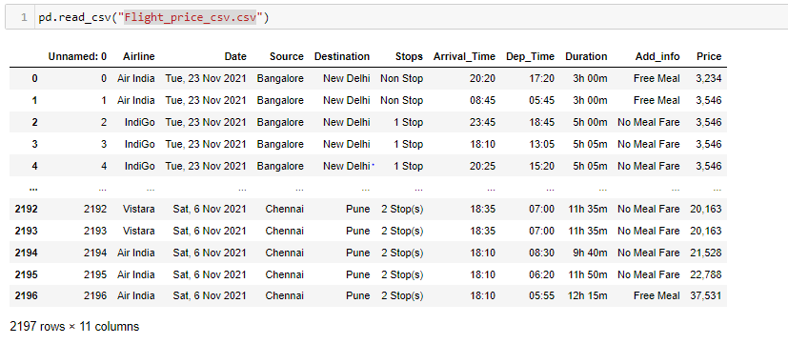
Collected Data

Slide 3
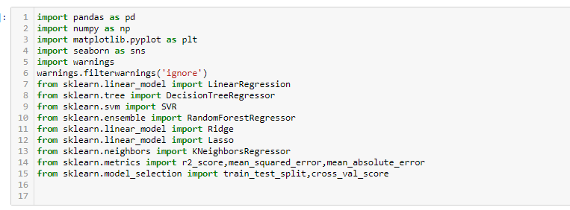
Importing libraries

Slide 4
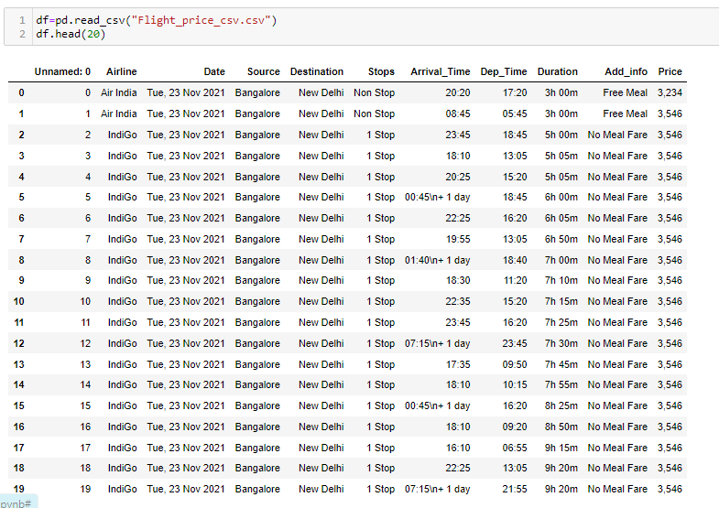
Load data set

Slide 5

Shape of the data set

Slide 6
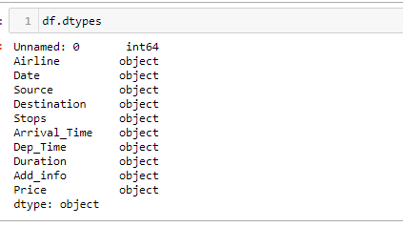
Checking data type of data set

Slide 7
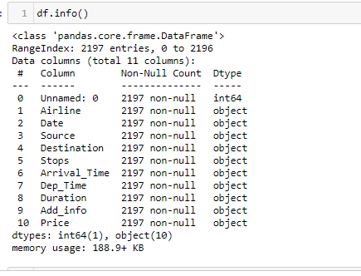
Short info about data set

Slide 8
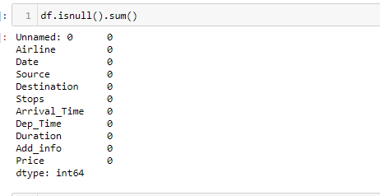
Checking missing values

Slide 9
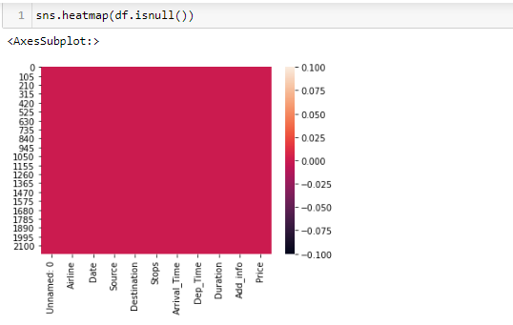
Null Values Heatmap

Slide 10
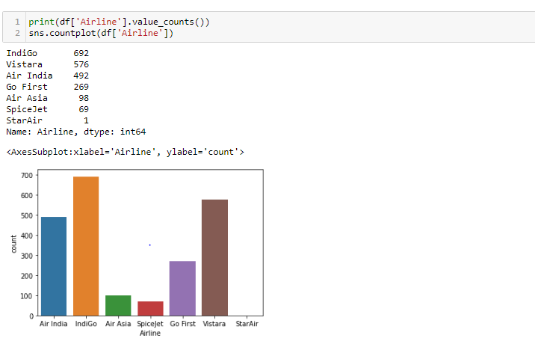
Visualization: airline column

Slide 11
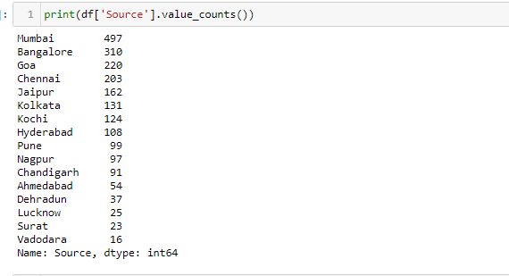
Source column

Slide 12
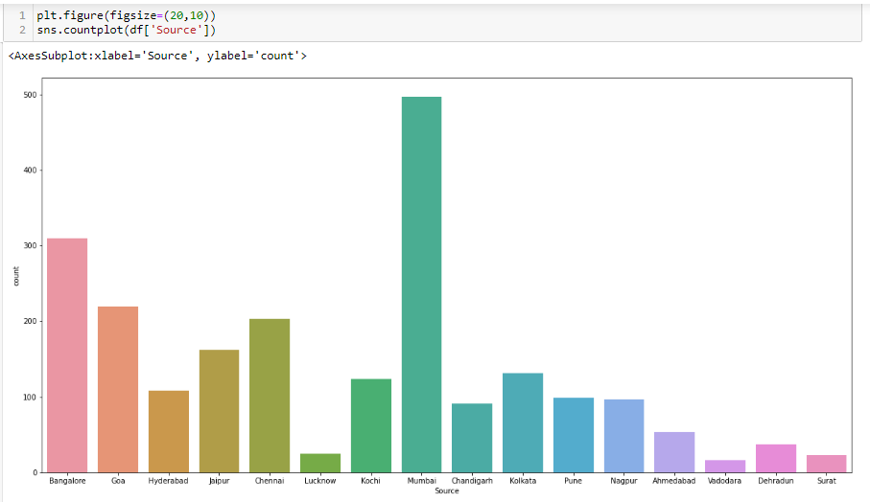
Source Plot

Slide 13
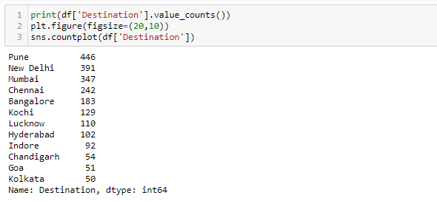
Destination column

Slide 14
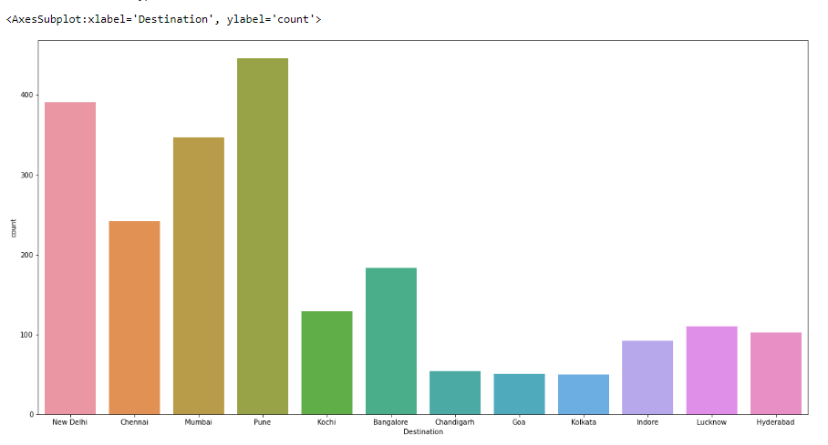
Destination Plot

Slide 15
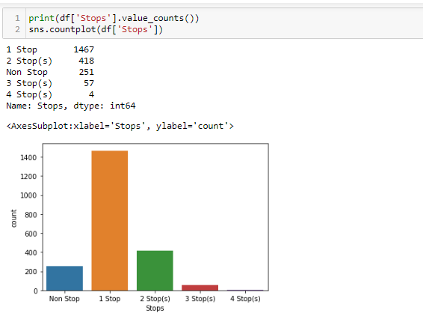
Stops column

Slide 16
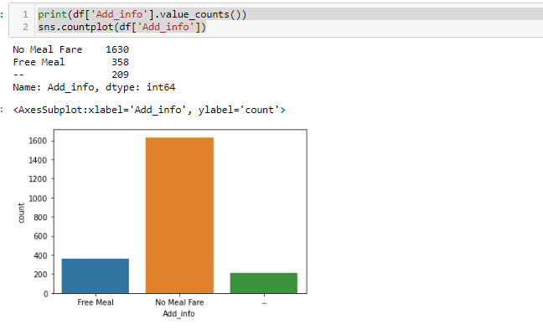
Addition values column

Slide 17
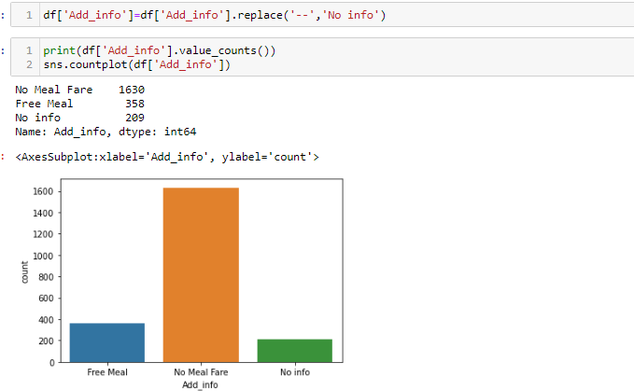
Meal Plot

Slide 18
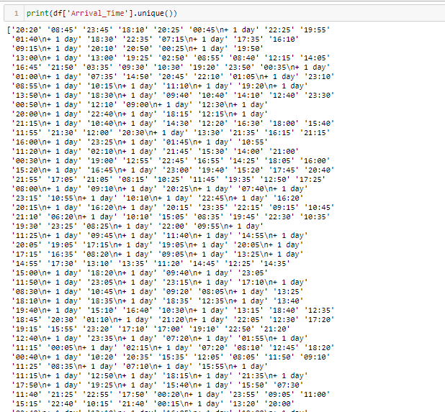
Arrival time

Slide 19
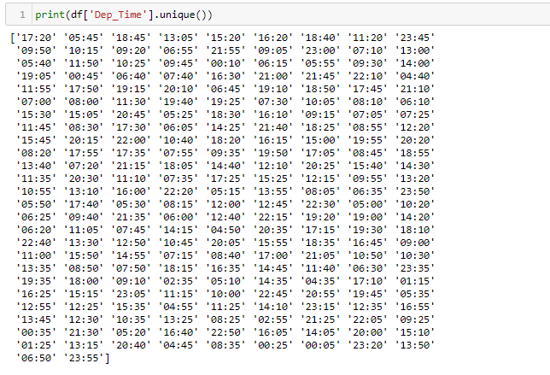
Departure time column

Slide 20
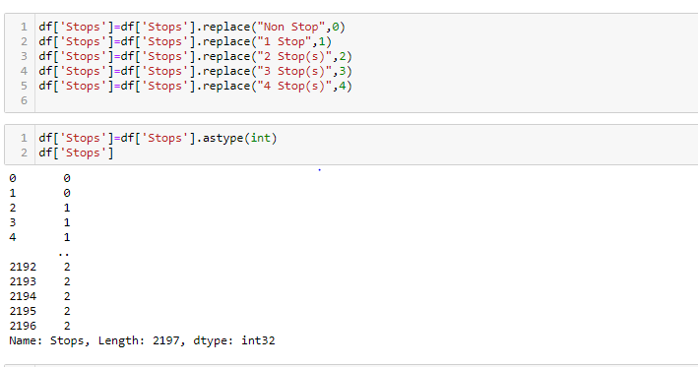
Data preprocessing

Slide 21
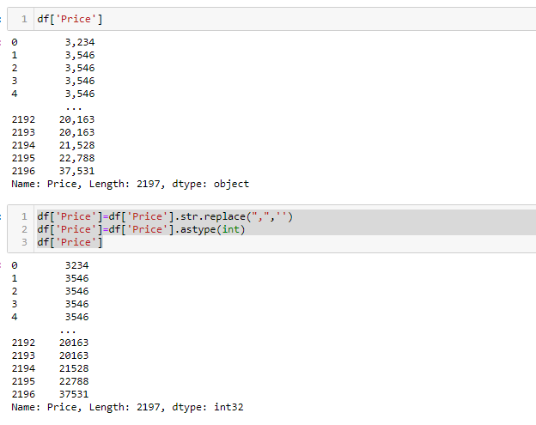
Price column

Slide 22
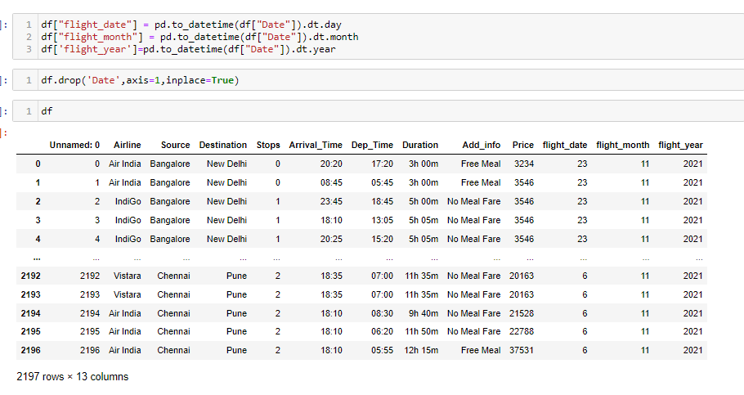
Deriving new columns

Slide 23
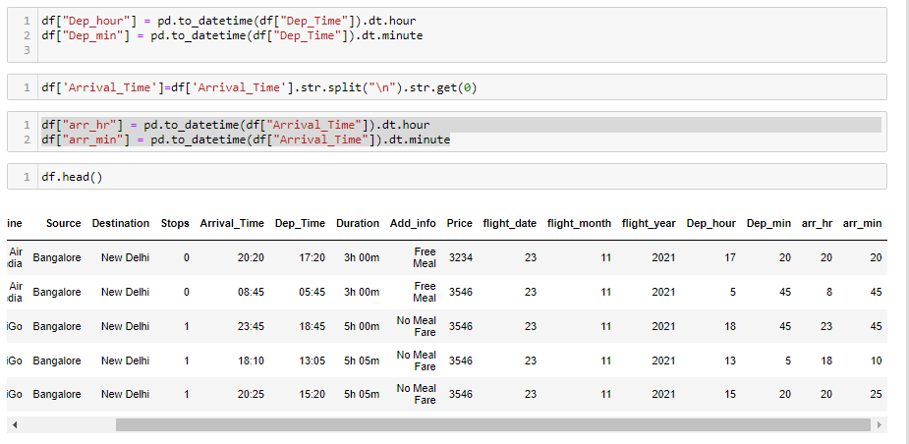
Departure & Arrival

Slide 24
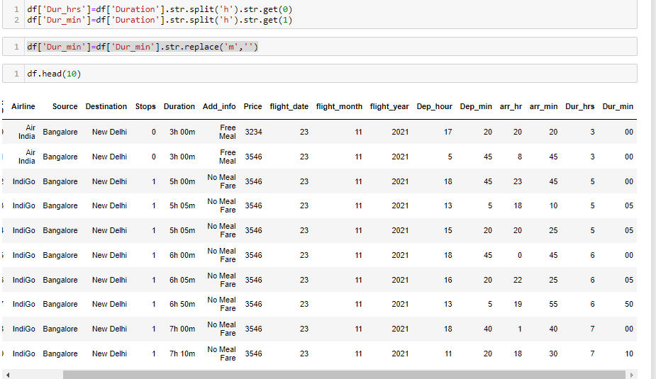
Flight Duration

Slide 25
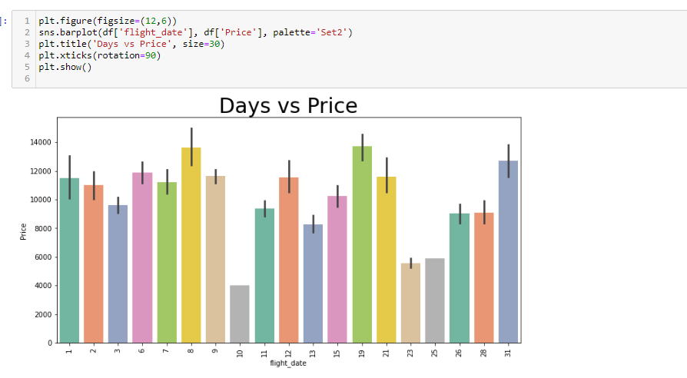
Days vs price

Slide 26
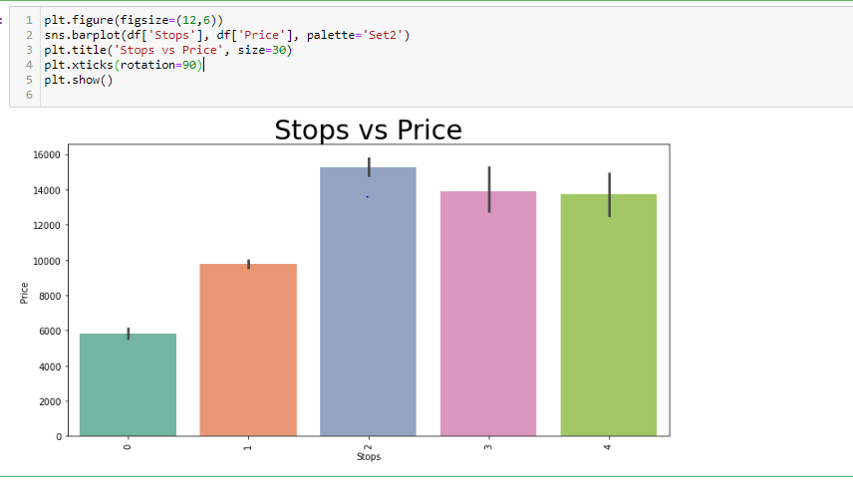
Stops vs price

Slide 27
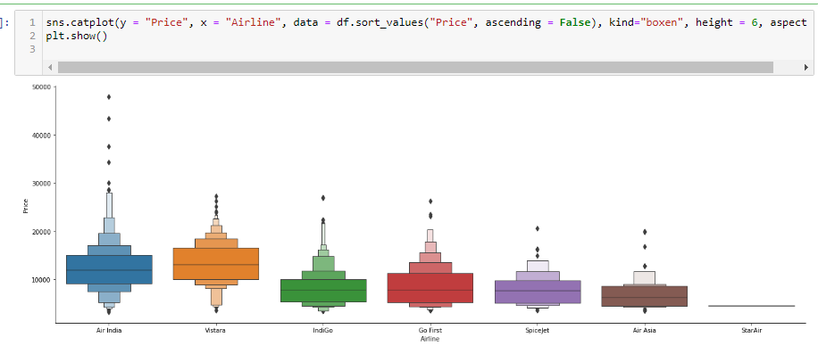
Airline vs price

Slide 28
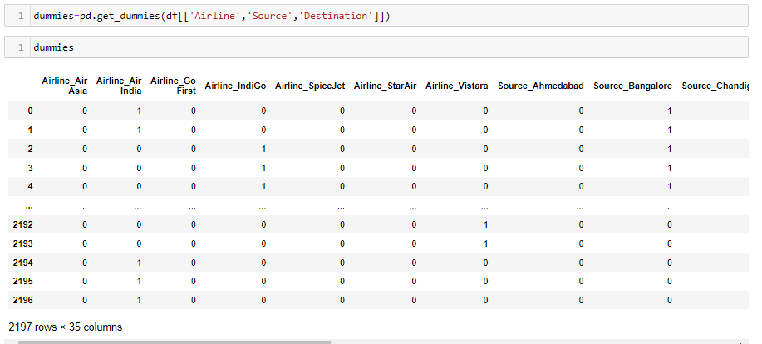
encoding

Slide 29
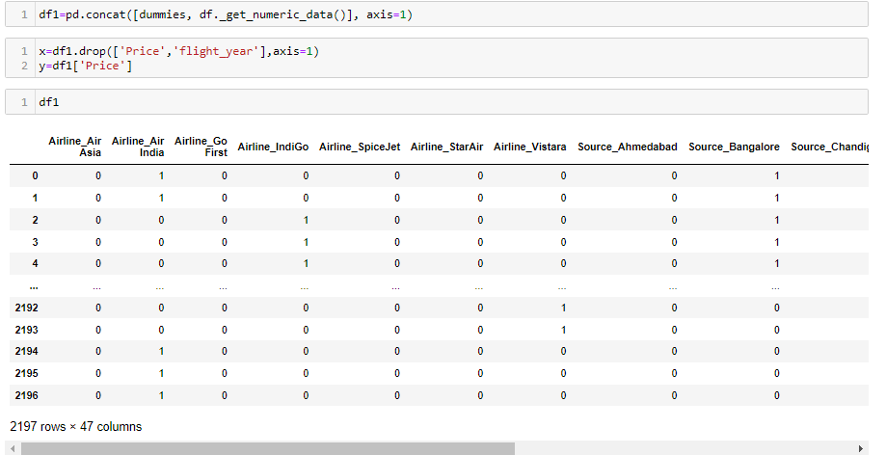

Slide 30

Feature importance

Slide 31
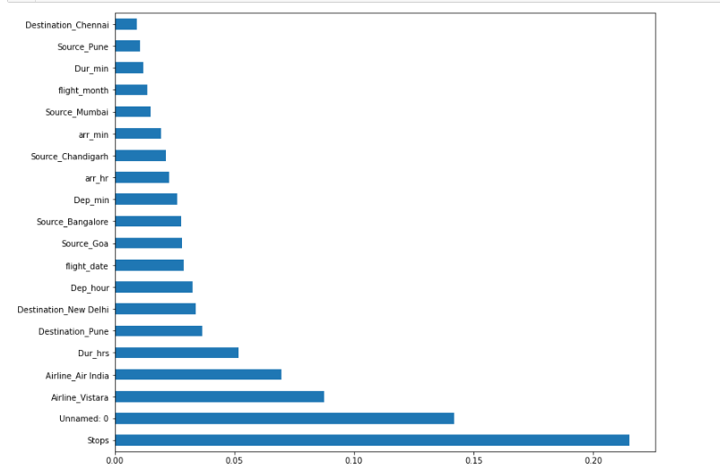

Slide 32

Train_test_split

Slide 33

Regression

Slide 34
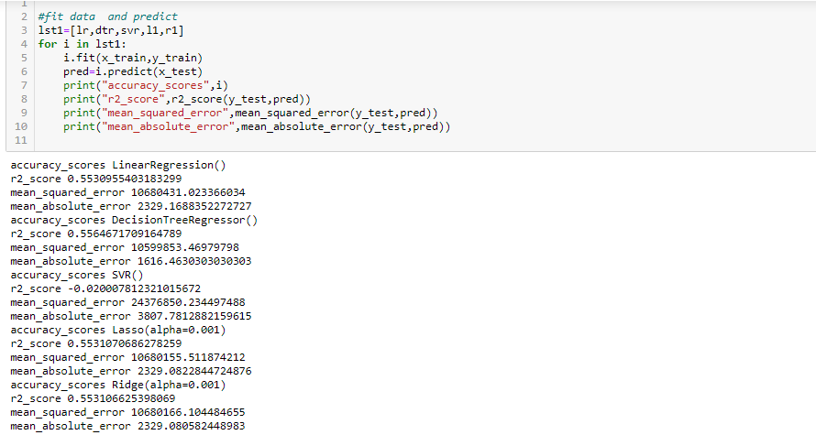
Fit and predict data

Slide 35
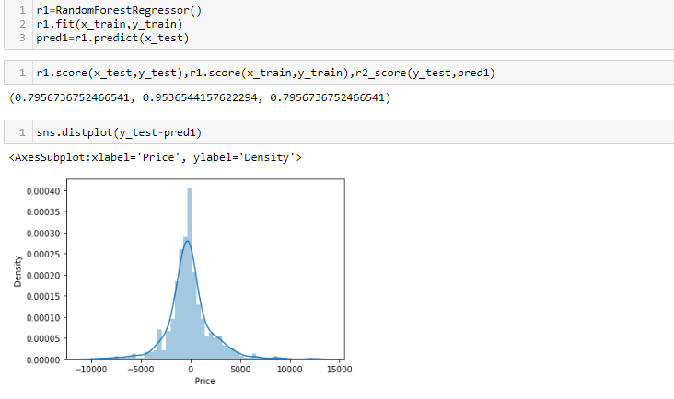

Slide 36
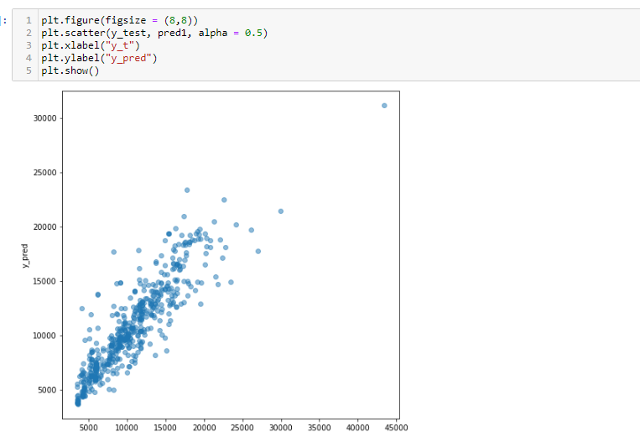

Slide 37
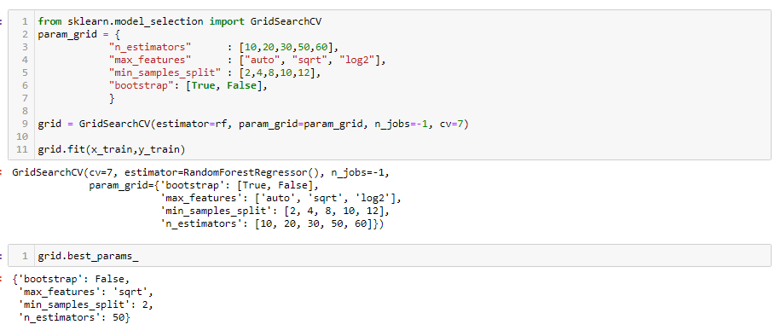
Hyper parameter tuning

Slide 38


Slide 39
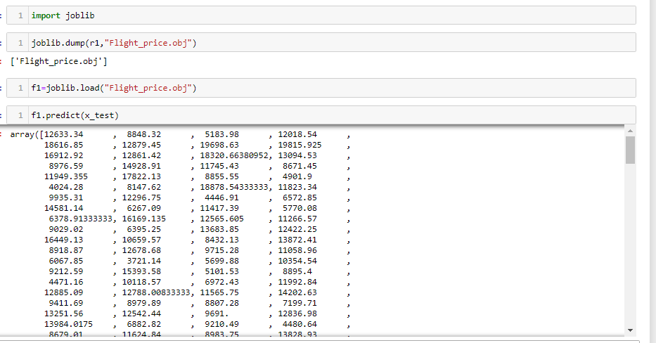
Create object file

Slide 40
Thanks

